Slide 1
HemoSys: Blood Management System
Group Members:
Ali Maaz 21i-0636
Waleed Asif 21i-0537

Slide 2
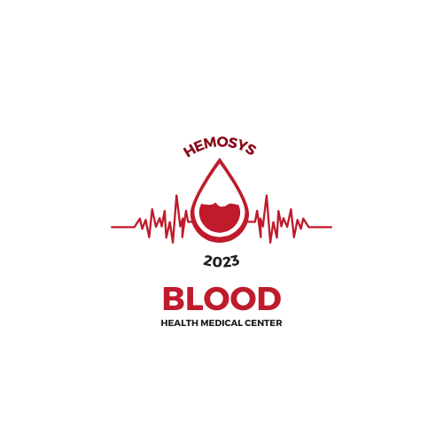
Project Overview
Objective: Revolutionize blood management for healthcare institutions, blood banks, and donors.
Key Features:
- User-friendly platform
- Robust inventory management
- Real-time transparency for healthcare facilities
Objectives: Enhance donor engagement, Predict demand efficient, Facilitate swift emergency responses

Slide 3

Use Cases
1. Register Donor
2. Record Blood Donation
3. Manage Blood Inventory
4. Search for Donors
5. Request Blood Transfusion
6. Manage Blood Drives
7. Authenticate Users and Roles
8. Generate Reports and Statistics
9. Notify Donors and Volunteers
10. Manage Donor Rewards Program
11. Blood Component Separation
12. Emergency Response Coordination

